Slide 1
Quote Tool - IEC
Li-Li Chen

Slide 2

Agenda
Quote Tool Introduction
Quote Tool Instruction
Limitation and Restriction of Tool
Quote Tool installation

Slide 3
Agenda
Quote Tool Introduction
Quote Tool Instruction
Limitation and Restriction of Tool
Quote Tool installation

Slide 4


Quote Tool Introduction
Delete CPCT
non-effectively date
Quote Validation
Enter
CPCT files’ path
Validation Date
Enter
Validation Date
Quote files’ Path
CPCT files’ Path
(1) CKIT filer's Path – NB, Media
(2) Sell Pricing file's Path
User
Click ‘CPCT Checker’ button
Click ‘Run Quote’ button
Delete non-effectively date (in red)
Save in a new folder
Check
CKIT, Master Data, BUSA
Tool

Slide 5
Quote Tool Introduction
CPCT Consolidation
HP Price Consolidation
Enter
CPCT files’ path
Enter
Validation Date
CPCT files’ Path
(1) CKIT filer's Path – NB, Media
(2) Sell Pricing file's Path
User
Click ‘HP Price Consolidation’ button
Consolidate
BUSA, option sum
Consolidate
CKIT, Master Data, BUSA, OP
Tool

Slide 6
Quote Tool Introduction
TW Quote Consolidation
Enter
Consolidation Date
TW CM files’ path
User
Tool
Consolidate/Separate
AV, SKU
check
if ‘SKU’ sheet has repetitive SKU+PN
6

Slide 7
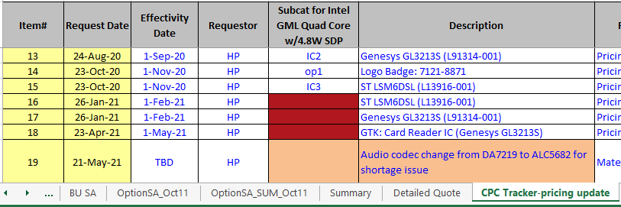
Quote Tool Introduction
Delete CPCT
non-effectively date
Deleted part will be filled in Red
Check both 'CPC Tracker-pricing update’ & 'CPC Tracker-spec change‘ sheet

Slide 8
Quote Tool Introduction
Quote Validation
Create a folder named as ‘Quote_Validation‘ and a file that validate CKIT, Sell Price, and BUSA. Also, it would consolidate all BUSA, OP, CKIT, and sell price HP quotes in ‘HP Price’ sheet.
CKIT
BU SA
Master Data

Slide 9
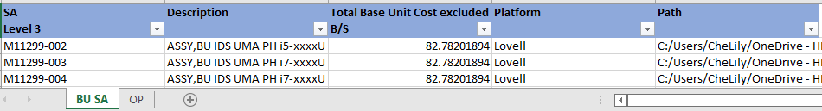
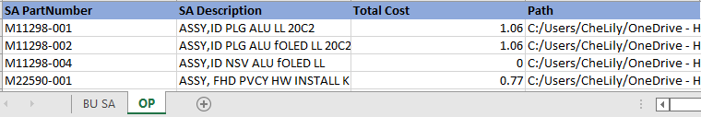
Quote Tool Introduction
CPCT Consolidation
Create a folder named as ‘CPCT_Consolidation’ and a file that consolidating BU SA & Option
BU SA
Option

Slide 10
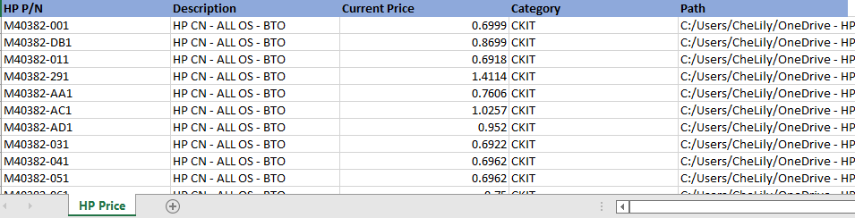
Quote Tool Introduction
HP Price_Consolidation
Create a folder named as ‘HP Price_Consolidation ‘ and a file that consolidate all BUSA, OP, CKIT, and sell price HP quotes in ‘HP Price’ sheet.
HP Price

Slide 11
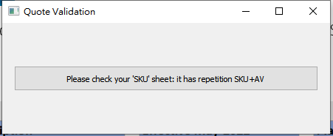
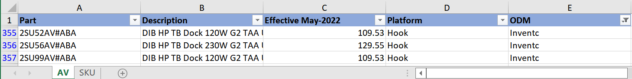
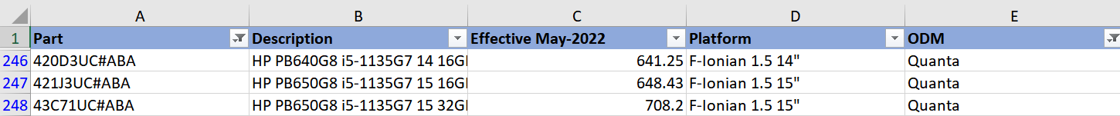
Quote Tool Introduction
Alert might pop up
if ‘SKU’ sheet has repetitive SKU+PN
TW Quote Consolidation
Create a folder named as ‘TW Quote Consolidation‘ and a file that consolidate/ separate all AV, SKU.(All PN contain ‘AV’ would be put in ‘AV’ sheet)
Also, it will check if ‘SKU’ sheet has repetitive SKU+PN
AV
SKU

Slide 12
Agenda
Quote Tool Introduction
Quote Tool Instruction
Limitation and Restriction of Tool
Quote Tool installation

Slide 13
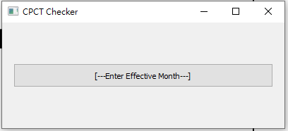
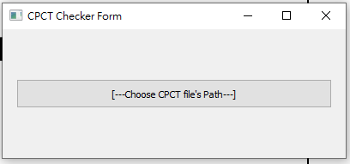

Delete CPCT non-effective date
Step2
Step3
Step1: Click “CPCT Checker” Button
Step2: Enter Effective Month
as in format like “01/2022”
Step3: Choose CPCT file Path
(The file output path will in the below cell)
Step1

Slide 14




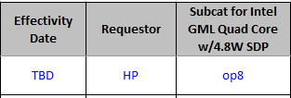
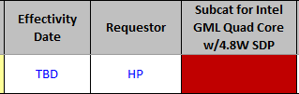
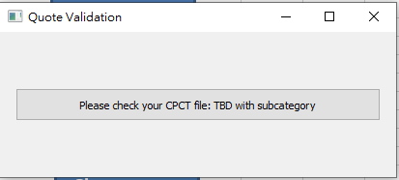
Delete CPCT non-effectively date
Delete the subcategory: Effectivity Date > validate date
Delete the subcategory: Effectivity Date = Imme, and Request Date > validate date
Delete the subcategory: Effectivity Date = TBD (but the subcatexxx is not null) >pop out Alert
Alert
Notes:
Please check your CPCT file: TBD with subcategory

Slide 15
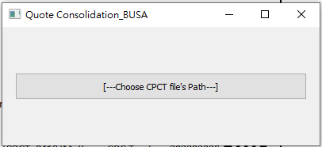
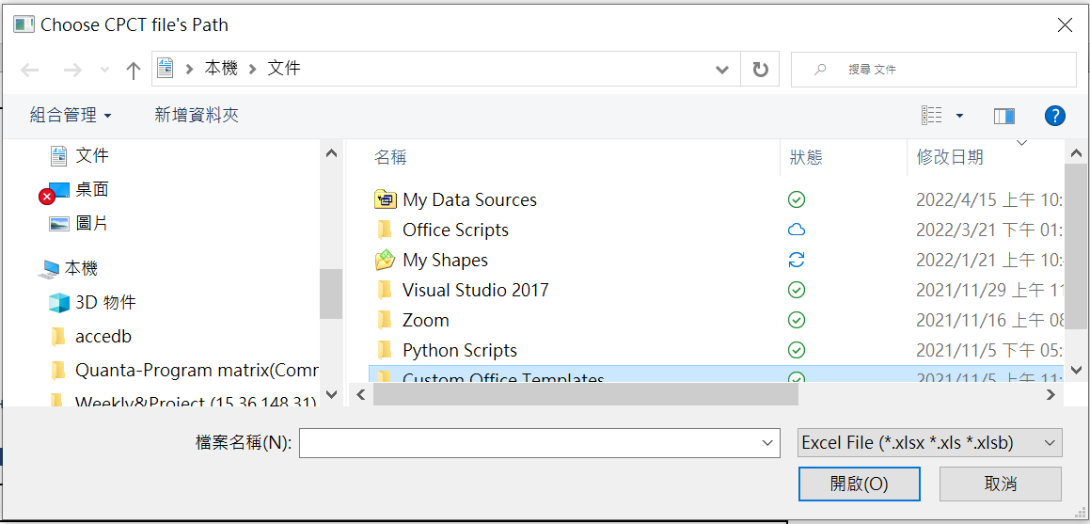
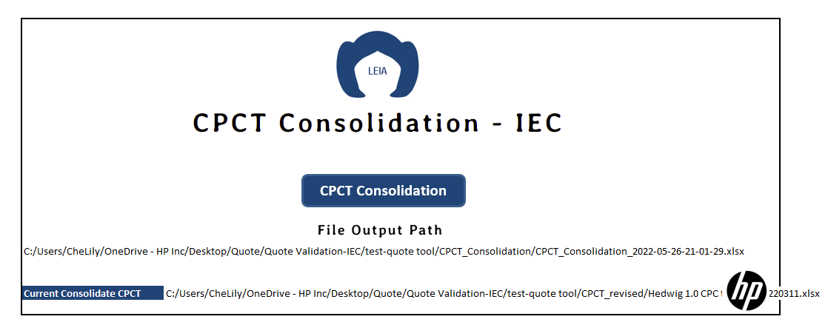
CPCT Consolidation
Step2
Step1: Click “Quote Validation”
Step2: Choose CPCT file's Path
Step1

Slide 16
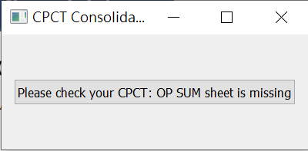
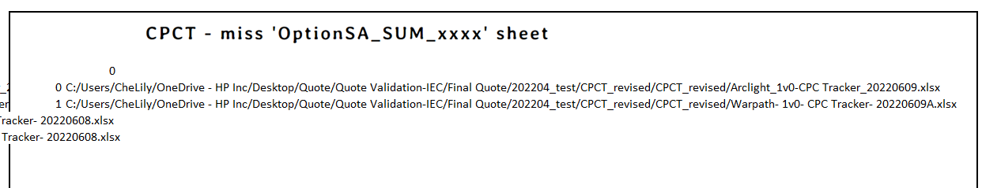
CPCT Consolidation
Alert:
If one of CPCT doesn’t have OptionSA_SUM_xxxx sheet, the waring below would pop up.
Also, the CPCT that miss OptionSA_SUM_xxxx sheet would show in Quote tool ‘CPCT Consolidation’ sheet

Slide 17
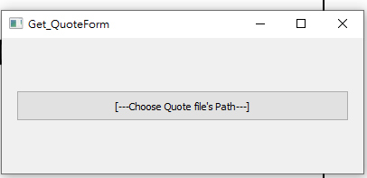
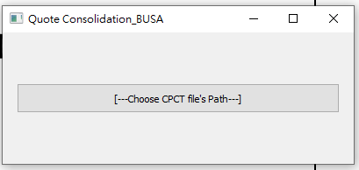
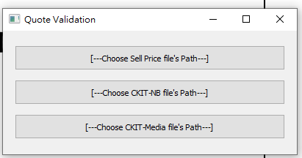

Quote Validation
Step2
Step3
Step4
Step1: Click “Quote Validation”
Step2: Choose Quote file’s path
Quote file's Path
CPCT file's Path
Step3: Choose CPCT file’s path
Step4: Choose Sell Price file, CKIT-NB, and CKIT-Media’s path
Step1

Slide 18
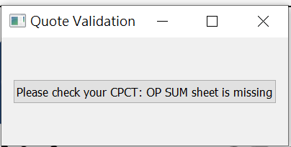
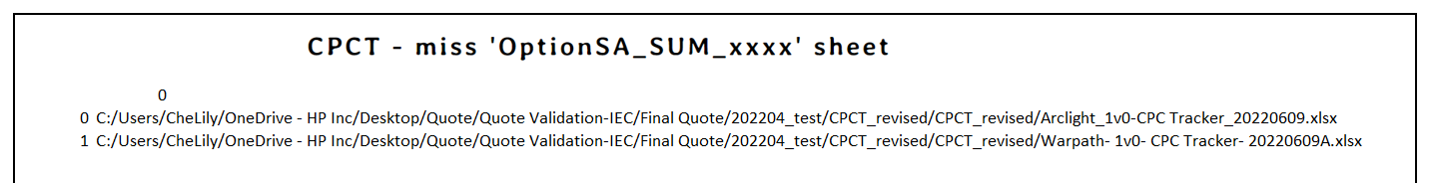
Quote Validation
Alert:
If one of CPCT doesn’t have OptionSA_SUM_xxxx sheet, the waring below would pop up.
Also, the CPCT that miss OptionSA_SUM_xxxx sheet would show in Quote tool ‘Quote validation’ sheet

Slide 19
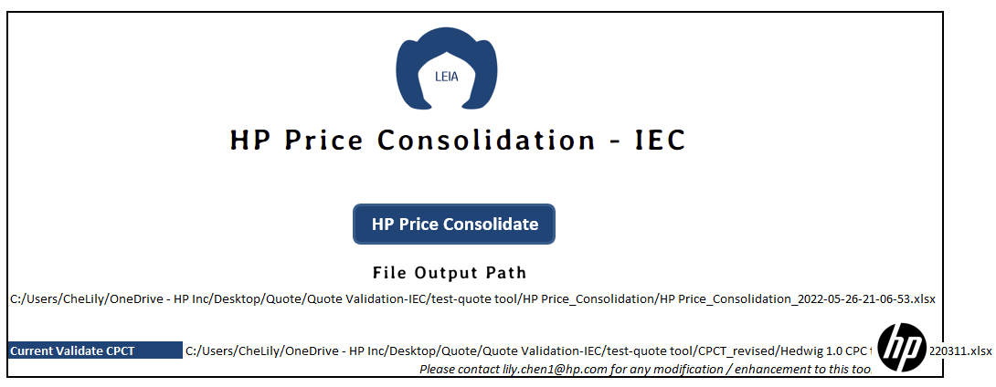
HP Price Consolidate
Step2
Step3
Step1: Click “HP Price Consolidate”
Step2: Choose CPCT file’s path
Step3: Choose Sell Price file, CKIT-NB, and CKIT-Media’s path
Step1

Slide 20
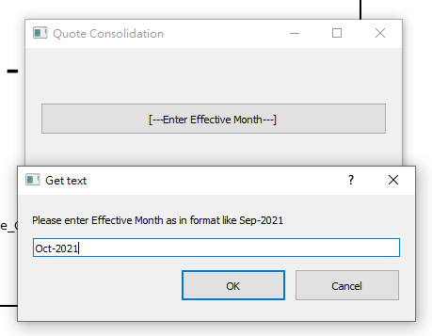
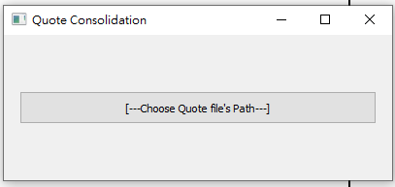

Step2
Quote Consolidation
Step3
Step1: Click Quote Consolidation button
Step2: Enter Effective Month
as in format like “Sep-2021”
Step3: Choose quote file path
Step1

Slide 21
Quote Consolidation
Alert:
Condition 1: price == 0 → comment showed 'AV Cost Not Updated’, ‘SKU Cost Not Updated’
Condition 2 : same AV or with different Price → comment showed ‘Same AV With Different Cost’, ‘Same SKU With Different Cost'

Slide 22
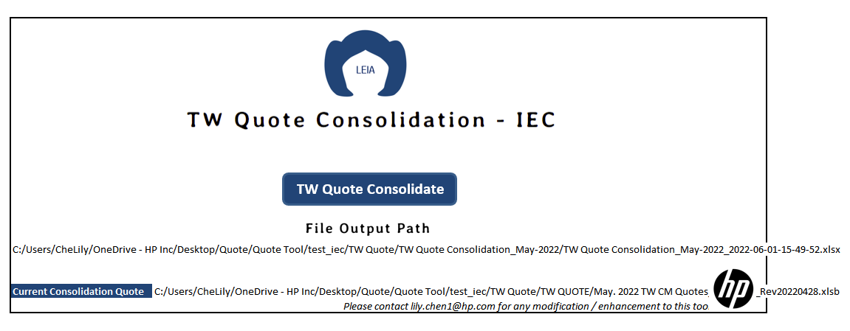
Step2
TW Quote Consolidation
Step3
Step1: Click TW Quote Consolidation button
Step2: Enter Effective Month
as in format like “Sep-2021”
Step3: Choose TW quote file path
Step1
22

Slide 23
Agenda
Quote Tool Introduction
Quote Tool Instruction
Limitation and Restriction of Tool
Quote Tool installation

Slide 24
Limitation and Restriction
Restriction
Limitation
1. Should set up the python environment
1. Time-consuming
2. KBD should be cleaned
2. Data Format is restricted ex:sheet’s name, column

Slide 25
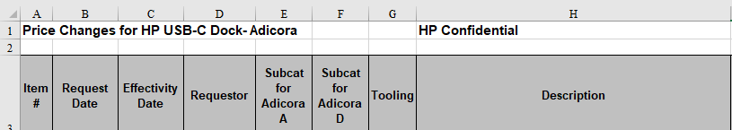
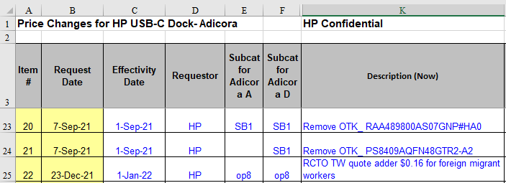
Restriction
Run “CPCT Checker”
Sheet name: should contain the below word
1. “CPC Tracker-spec change” , “CPC Tracker-Spec change”, or “CPC Tracker-Spec Change”, (CPC Tracker-spec changeXXX is fine),
2. “CPC Tracker-pricing update”, “CPC Tracker-Pricing update”, or “CPC Tracker-Pricing Update” or “CPC (GTK)Tracker-pricing update”
Header: - “CPC Tracker-spec change” sheet needs to have “Requestor”, “Description”, “Request Date”, and “Effectivity Date” on the heading.
Heading needs to be in Row #3 or Row #2.
Header: - “CPC Tracker-pricing update” sheet needs to have “Requestor”, “Description”, “Request Date”, and “Effectivity Date” on the heading. (only Description xxx is fine, the other column should be exactly same)
Heading needs to be in Row #3 or Row #2.

Slide 26

Restriction
2. Run “Quote Validation”
‘Quote’ -“Change Log”
Sheet name: should be exactly named as “Change Log” or “Change log”
Platform name should be exactly at the same locations
‘Quote’ -“CKIT”
Sheet name: should contain “CKIT” (CKIT XXX is fine)
Header: : should be exactly named as 'HP Part #', 'Type’ and contain “Current” (Current XXX is fine)
Heading needs to be in Row #1

Slide 27

Restriction
2. Run “Quote Validation”
‘Quote’ -“Master Data”
Sheet name: should contain “Master Data” or “Master data” (Master Data XXX is fine)
Header: should be exactly named as 'Description', 'Category‘ and contain “HP” and “Current”
(HP XXX is fine)
Heading needs to be in Row #1
‘Quote’ -“BU SA”
Sheet name: should contain “BUSA” or “BU SA” (BU SA XXX is fine)
Header: should be exactly named as 'Description', 'Total Base Unit Cost excluded B/S’ and contain “HP” or “SA”
(HP XXX is fine)
Heading needs to be in Row #1

Slide 28

Restriction
2. Run “Quote Validation”
‘CPCT’ -“BU SA”
Sheet name: should be exactly named as “BU SA” (BU SA XXX is not allowed)
Header: should be exactly named as ‘SA Level 3’, 'Description’, and 'Total Base Unit Cost excluded B/S’
Heading needs to be in Row #1
‘CPCT’ -“OptionSA_SUM” (not required)
Sheet name: should contain “OptionSA_SUM” (OptionSA_SUM XXX is fine)
Header: : should be exactly named as ‘SA PartNumber', 'SA Description’ and ‘Total Cost’
Heading needs to be in Row #1

Slide 29
Restriction
2. Run “Quote Validation”
‘CKIT Media’
Sheet name: no restriction, will go through every sheet (neglect hidden sheets)
Header: should be exactly named as ‘HP P/N’, ‘Description’, and “Current Price”
Heading needs to be in Row #1
‘CKIT NB’ -“Doc Kit SKU Summary-1”
Sheet name: should be exactly named as “Doc Kit SKU Summary” and “Doc KIT SKU summary for HP”
Header: should be exactly named as ‘HP P/N’, ‘Description’, and “Current Price”
Heading needs to be in Row #1

Slide 30
Restriction
2. Run “Quote Validation”
‘Sell Pricing’ -“Master Data”
Sheet name: should be exactly named as “Master Data” (Master Data XXX is not allowed)
Header: should be exactly named as ‘HP P/N’, ‘Description’, and “Current Price”
Heading needs to be in Row #1

Slide 31

Restriction
3. Run “Quote Consolidation”
‘Change Log’
Sheet name: should be exactly named as “Change Log” or “Change log”
Platform name & ODM should be exactly at the same locations
‘AV Summary’
Sheet name: should be exactly named as “AV Summary” or “AV summary”
Header: no needs to be exactly at the same locations,
but the header name should exactly be named as ‘AV', 'Description’ and contain ‘Current’ or ‘Effective’
Heading needs to be in Row #1
‘SKU Summary’
Sheet name: should be exactly named as “SKU Summary” or “SKU summary”
Header: no needs to be exactly at the same locations,
but the header name should exactly be named as 'SKU', 'Description’ and contain ‘Current’ or ‘Effective’
Heading needs to be in Row #1

Slide 32
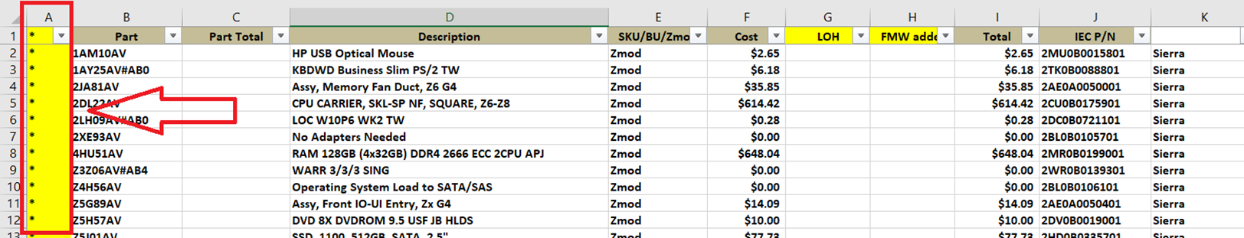
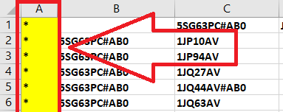
Restriction
4. Run “TW Quote Consolidation”
‘Summary’
Sheet name: should be exactly named as “Summary”
Header: needs to be exactly at the same locations
Heading needs to be in Row #1
‘SKU’
Sheet name: should be exactly named as “SKU”
Header: needs to be exactly at the same locations
Heading needs to be in Row #1

Slide 33
Restriction
5. Run “CPCT Consolidation”
‘CPCT’ -“BU SA”
Sheet name: should contain “BUSA” or “BU SA” (BU SA XXX is fine)
Header: should be exactly named as 'Description', 'Total Base Unit Cost excluded B/S’ and contain “HP” or “SA”
(HP XXX is fine)
Heading needs to be in Row #1
‘CPCT’ -“OptionSA_SUM” ” (not required)
Sheet name: should contain “OptionSA_SUM” (OptionSA_SUM XXX is fine)
Header: : should be exactly named as ‘SA PartNumber', 'SA Description’ and ‘Total Cost’
Heading needs to be in Row #1

Slide 34
Agenda
Quote Tool Introduction
Quote Tool Instruction
Limitation and Restriction of Tool
Quote Tool installation

Slide 35

Quote Tool installation
https://www.python.org/downloads/
Click Download button

Slide 36
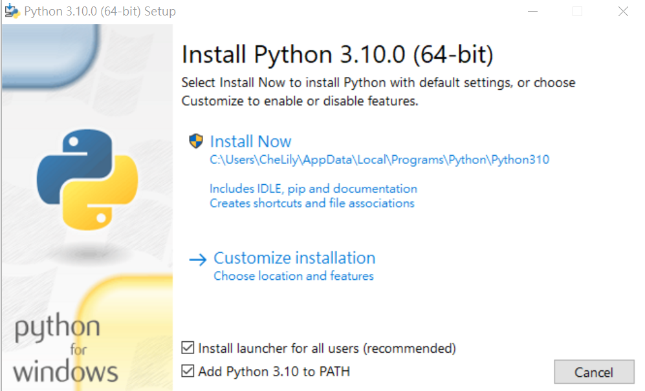
Quote Tool installation
Click “Add Python 3.10 to PATH”, then use the default settings

Slide 37
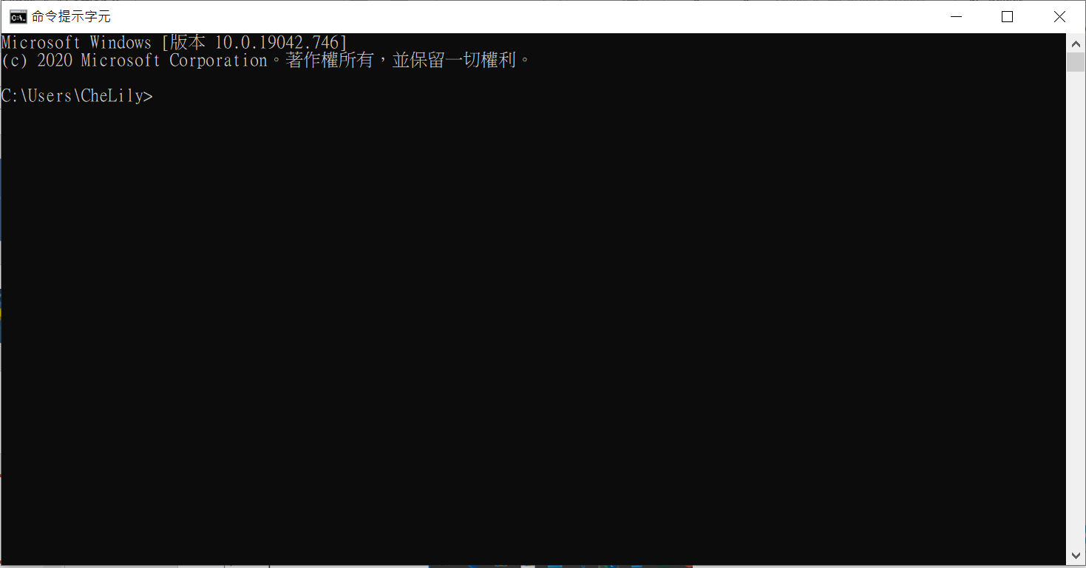
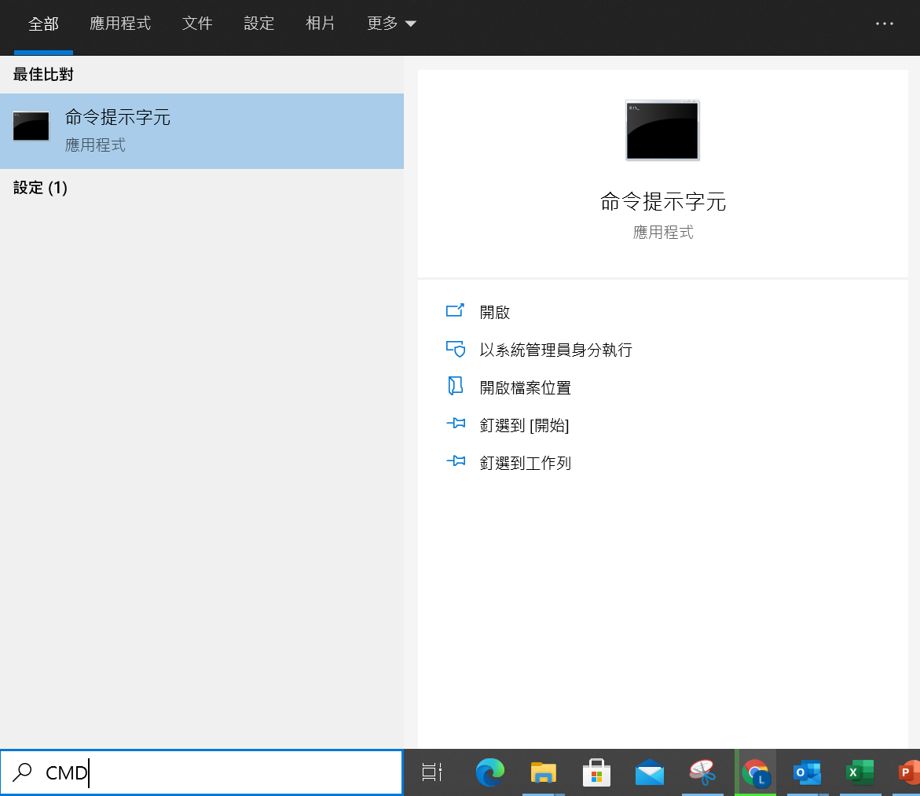
Quote Tool installation
Click “命令提示字元” or “cmd.exe”

Slide 38
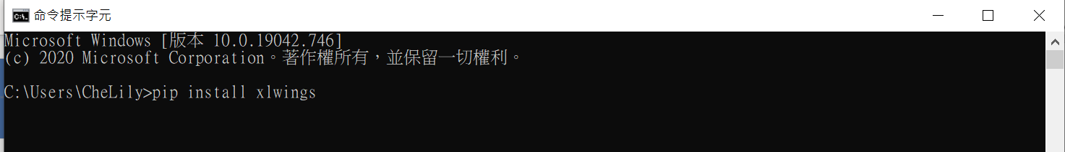
Quote Tool installation
1. Type “pip install xlwings”, then click enter button
(If it shows “Proceed ([y]/n)?” Type “Y”, then click enter button)
2. Type “xlwings addin install”, then click enter button
3. Type “pip install pyxlsb”, then click enter button
4. Type “pip install pandas”, then click enter button
5. Type “pip install numpy”, then click enter button
6. Type “pip install datetime”, then click enter button
7. Type “pip install openpyxl”, then click enter button
8. Type “pip install PyQt5”, then click enter button
9. Type “pip install XlsxWriter”, then click enter button

Slide 39
Thank you

